Slide 1
From Domain to Development: Everything you need to Build an Online Presence

Slide 2
Agenda
Domain name recommendation and research
Content writing research and writing
Stripe setup and integration
Web design recommendations
Company and EIN number registration
Social media setup
Paid add setup
SEO and blogging
Google my business
Lead
Website development and hosting

Slide 3
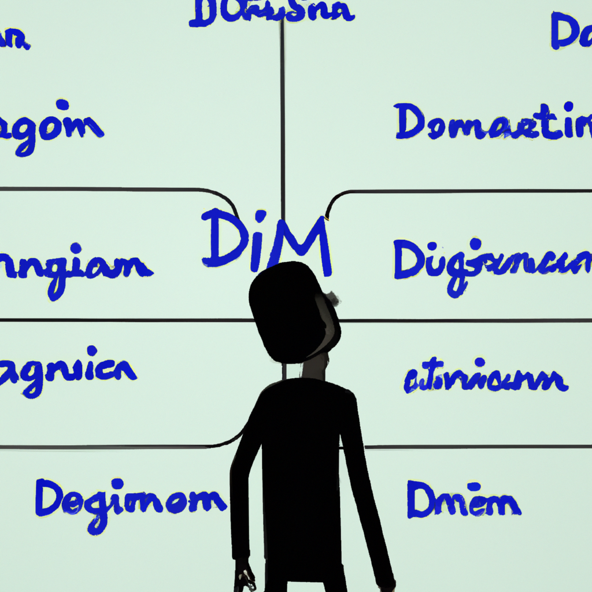
Domain Name Recommendation and Research
We understand the importance of selecting the perfect domain name for your website, and we're here to help you with that. Our team will guide you in choosing a domain name that is easy to remember, relevant to your business, and incorporates keywords related to your industry. We will conduct comprehensive research to ensure that the domain name you choose is not already taken or infringing on someone else's trademark. With our expertise, you can rest assured that your website will have a strong online presence with the perfect domain name.

Slide 4
We will assist you in brainstorming potential domain names that align with your brand image and values. We will then conduct a thorough availability check using reputable domain registrars like GoDaddy or Namecheap to ensure that your desired domain is available.
We'll also verify if the shortlisted domain names are available on popular social media platforms to establish a consistent online identity for your brand. We recognize the significance of a memorable and cohesive online presence that reflects your brand, which is why we go the extra mile to ensure your social media handles are available.

Slide 5
Content Writing Research and Writing
Conducting extensive research on your target audience, competitors, and industry trends to ensure that the content we create is informative and engaging.
Using cutting-edge tools like Google Analytics and SEMrush to analyze your competitors' content and identify gaps in the market.
By leveraging our expertise, you can rest assured that your website's content will stand out in today's crowded digital landscape.

Slide 6
To ensure that your content is visually appealing, we will use images and videos to break up the text and provide a more engaging experience for your audience. Our team will also thoroughly proofread your content, ensuring that it is free of any errors.

Slide 7
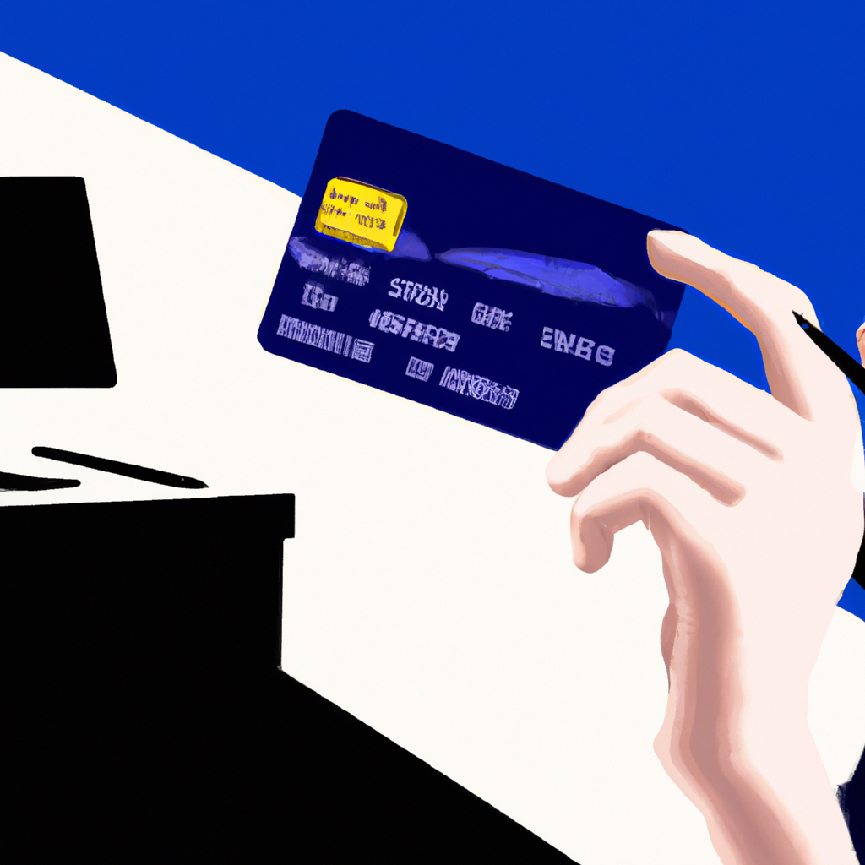
Stripe Setup and Integration
Stripe, a widely used payment processing platform, for your business. By integrating Stripe into your website, you can easily and securely accept online payments from your customers.
To get started with Stripe, we will create an account on your behalf and gather some basic information about your business. Once the account is set up, we will seamlessly integrate Stripe into your website using plugins or APIs.
Understanding importance of securing your customers' payment information. That is why we will ensure that all relevant regulations, such as PCI DSS compliance, are adhered to. You can trust us to take the necessary steps to keep your customers' payment data safe.

Slide 8
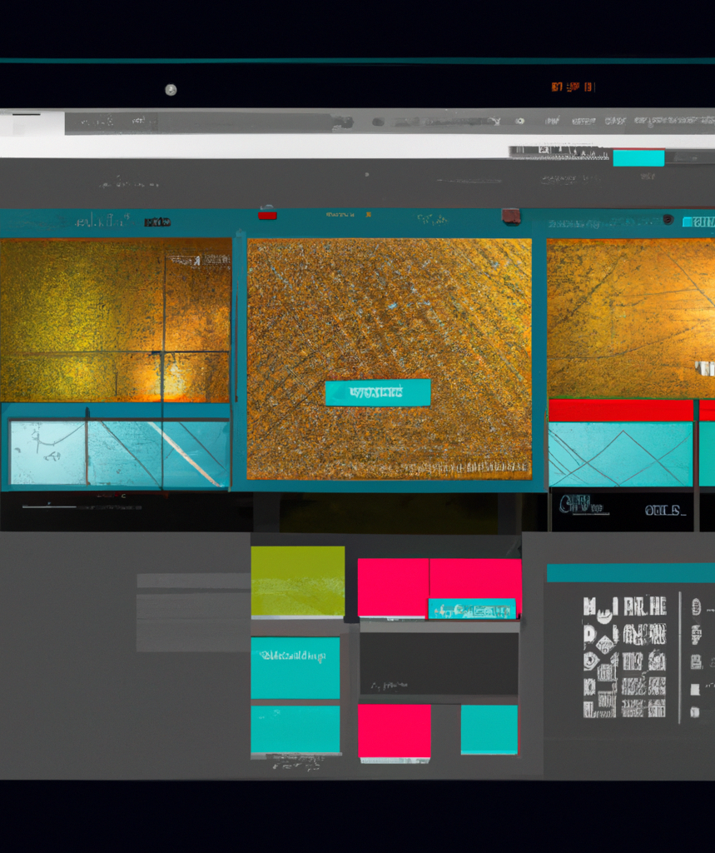
Web Design Recommendations
Assisting you in creating a website that provides an exceptional user experience.
Website should be easy to navigate and visually appealing. We will ensure that your website is optimized for all devices, including mobile devices.
Our designers will work with you to develop a color scheme that aligns with your brand, creating a cohesive and professional look.

Slide 9
By strategically placing CTAs, we aim to encourage your website visitors to take action, whether it's making a purchase, filling out a contact form, or subscribing to your newsletter. Our team of experts carefully analyzes your website and creates tailored CTAs that align with your brand's goals.
Moreover, we use A/B testing to determine which CTAs are the most effective in converting your website visitors into loyal customers. This process helps us to continuously improve your website's performance and ensure that your business is thriving online.

Slide 10
Company and EIN Number Registration
Registering the company and obtaining an Employer Identification Number (EIN) is a necessary step for any business. To register your company, you'll need to choose a business structure, such as a sole proprietorship, partnership, LLC, or corporation. Each structure has its own advantages and disadvantages, so it's important to choose the one that best suits the needs of the business.

Slide 11
Once your company is registered, you'll need to obtain an EIN from the IRS. This is a unique identifier that is used for tax purposes. You can apply for an EIN online through the IRS website. Finally, make sure to comply with all relevant tax laws and regulations to avoid penalties and fines.

Slide 12
Social Media Setup
Effectively promote your business and reach new customers through the power of social media. We guide you in setting up social media accounts on platforms that are most relevant to your business, including Facebook, Twitter, Instagram, and LinkedIn.
It is important to have a consistent brand image across all social media platforms. We =create a compelling brand image that resonates with your target audience by ensuring that your profile pictures, cover photos, and bios are all consistent and on-brand.

Slide 13
Social media marketing is the most cost-effective way to grow your audience and build engagement that drives recommendations and further conversions. Some social media platforms, like Facebook, are essential for every company. Others, like LinkedIn, depend upon your business and goals.
Once the accounts are set up, we start posting content that is relevant and engaging to your target audience. We use analytics tools to track the performance and adjust our strategy as needed.

Slide 14
Paid Ad Setup
Our paid advertising services include bidding strategies, ad creation, targeting options, and ongoing optimization to ensure maximum ROI for your investment. We understand the importance of reaching your target audience and standing out among your competitors, and we are committed to delivering results that meet your business objectives.

Slide 15
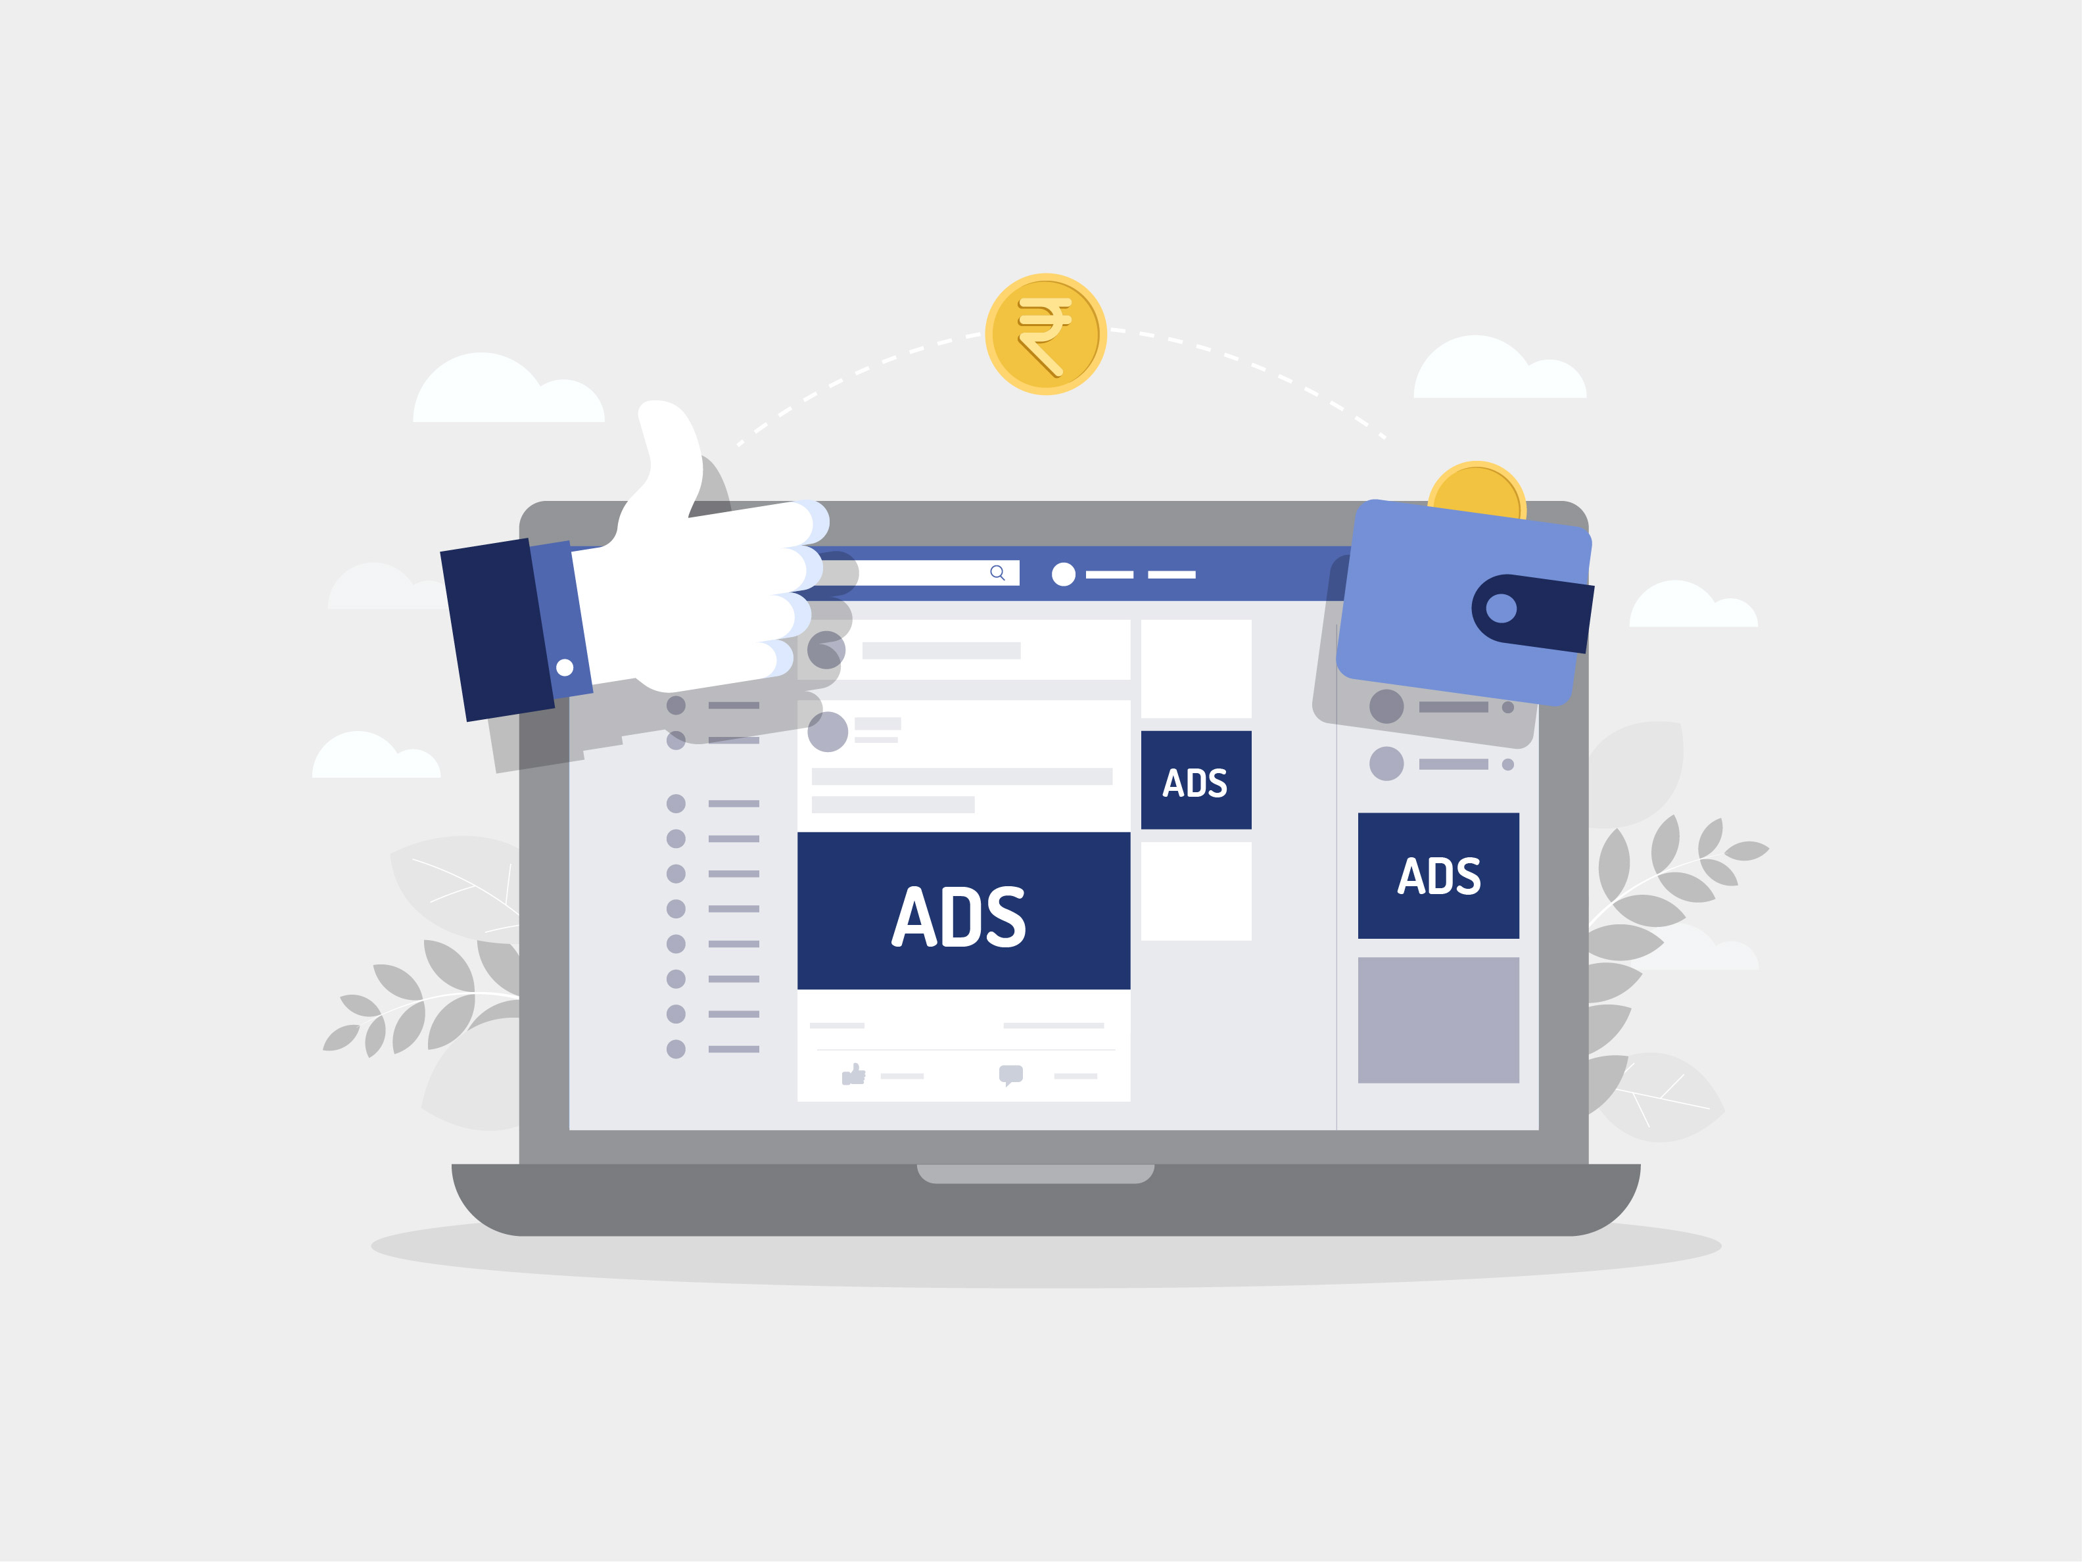
Specialized in setting up effective ad campaigns for our clients.
Understanding the importance of identifying your target audience and crafting ad copy that speaks to their needs and interests.
Prioritizing selecting the optimal keywords and bidding strategy to ensure that your ads are displayed to the right audience at the most opportune moments.

Slide 16
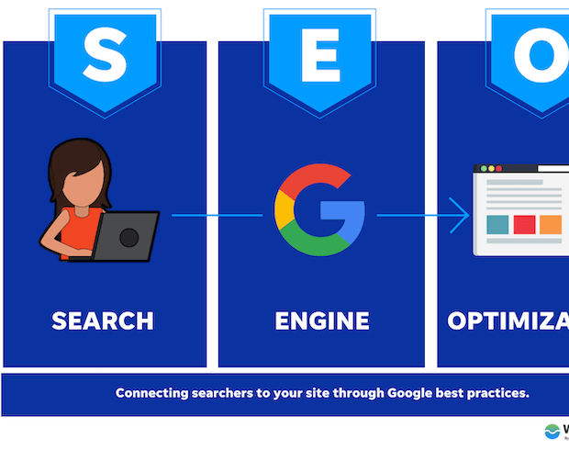
SEO and Blogging
SEO stands for “search engine optimization.” In simple terms, SEO means the process of improving your website to increase its visibility in Google, Microsoft Bing, and other search engines whenever people search for:
Products you sell.
Services you provide.
Information on topics in which you have deep expertise and/or experience.
Improving the visibility of your website's pages in search results. We understand the importance of being easily found and clicked on by potential customers, clients or an engaged audience. Our team of experts is dedicated.

Slide 17
Incorporate blogging into your content marketing strategy. With our expertise in creating high-quality, informative blog posts, we can help you attract more visitors to your website and improve your search engine rankings.
Build a loyal readership and establish your brand as an authority in your industry. Our team of skilled writers will work closely with you to develop a content plan that aligns with your business goals and provides value to your audience.

Slide 18
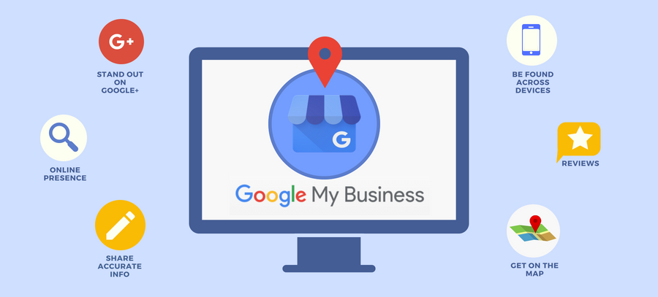
Google My Business
Google My Business is a free tool that allows businesses to manage their online presence across Google, including search and maps. By claiming and verifying your business on Google My Business, you can ensure that your business information is accurate and up-to-date, and that potential customers can easily find you online.
Gaining visibility on Google is crucial for the success of your business, and that's why we are committed to helping you achieve this goal. As part of our comprehensive SEO and lead generation services, we can create a Google Business Profile for your business.
Creating a Business Profile is not enough to reap its full benefits. That's why we will also provide you with the necessary management and editing capabilities that will enable you to fully leverage the power of your Business Profile as an effective SEO and lead generation tool.

Slide 19
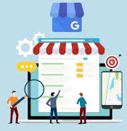
Engage with your customers by responding to reviews and posting updates on your behalf. This will help you build stronger relationships with your customers and improve your online reputation. With our help, you can focus on what you do best while we take care of the rest."

Slide 20
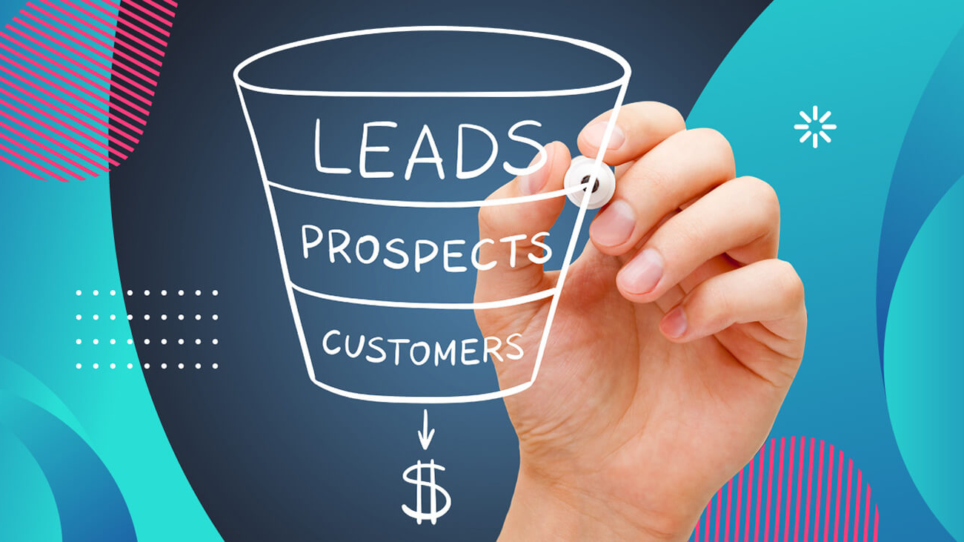
Lead generation - the process of attracting and converting potential customers into leads.
Using targeted marketing campaigns that are designed to capture the attention of your target audience and encourage them to take action.
We create compelling marketing messages that will resonate with your target audience and motivate them to take the next step.
Lead Generation

Slide 21
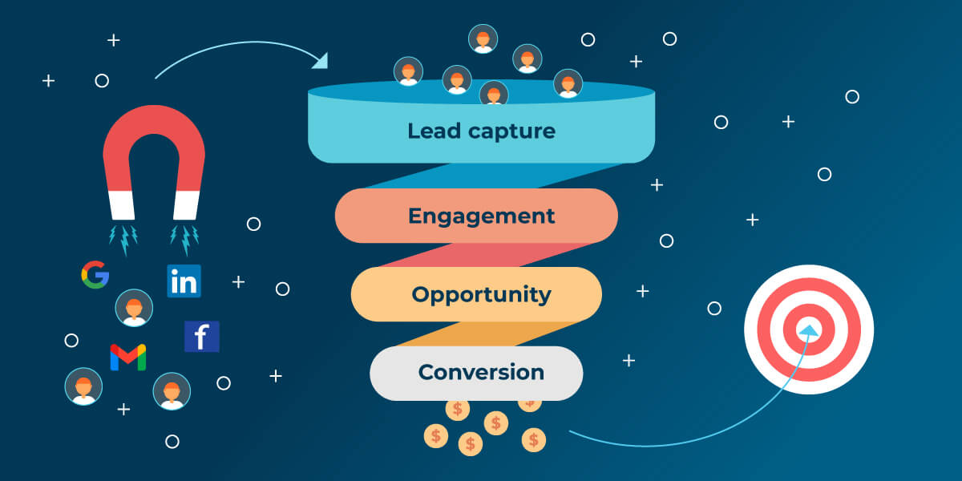
Why we offer content marketing services. Through our expertise in creating high-quality and informative content, we can help address the needs and pain points of your target audience. This, in turn, will attract more visitors to your website and convert them into valuable leads. Let us help you elevate your lead generation efforts through content marketing."

Slide 22
Website Development and Hosting
Web development refers in general to the tasks associated with developing websites for hosting via intranet or internet. The web development process includes
web design
web content development
client-side/server-side scripting
network security configuration, among other tasks.
A website is the foundation of your online presence, so it's important to invest in high-quality website development and hosting. A well-designed website that is easy to navigate and optimized for search engines can help you attract more visitors and convert them into customers

Slide 23
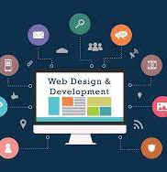
We offer web hosting services that prioritize reliability, security, and exceptional customer support. By choosing us as your web hosting provider, you can rest assured that your website will have fast loading times and minimal downtime, allowing your customers to always access your website.
We understand the importance of having a website that is always available to your customers, which is why we have invested in top-of-the-line technology and infrastructure to ensure maximum uptime. Our dedicated team of experts is available round-the-clock to provide you with any assistance you may need and ensure your website is running smoothly.

Slide 24
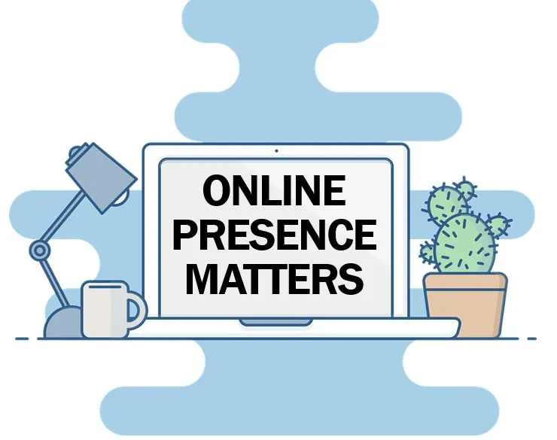
Conclusion
In conclusion, there are many different elements that go into building a successful online presence. From paid advertising to SEO and blogging, Google My Business, lead generation, website development and hosting, there are many different strategies that we use to attract more visitors to your website and convert them into customers.
By focusing on creating high-quality, valuable content that addresses the needs of your target audience and investing in the right tools and services, we build a strong online presence that will help you achieve your business goals.

